Slide 1
Tottenhall Infant School
Reception Curriculum
Spring Term
Information For Parents and Carers

Slide 2
Contents
Phonics
Reading Practice
Writing
Spring 1
Spring 2
School Uniform and PE Kit reminders
Home Learning
Questions & Contact Details

Slide 3
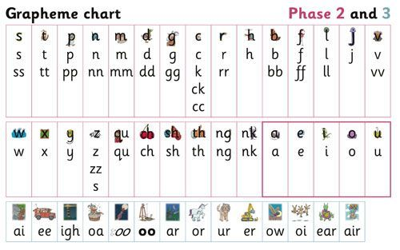
Phonics
Phase 2 now complete
Children who have not grasped all of the letters and sounds taught so far, will have additional ‘keep up’ sessions in school
Important the phonics videos are watched at home – these have been sent via home learning
More information about phonics in the parents phonics meeting- TBC

Slide 4
Reading Practice
Reading practice takes place once a week in class, also additional opportunities to read throughout the week
Small groups
Books match the phonics level of the children. They only contain sounds and words the children have been taught so far
Important the Big Cat book we send home with the children is read everyday

Slide 5
Writing
We use letter-join
Weekly handwriting practise
We start with patterns first and then move onto letters, pre-writing shapes
Helping at home

Slide 6
Spring 1
This half term, in Maths we will be revisiting the following skills:
Subitising- recognising the amount without counting
Counting, ordinality (order of the numbers) and cardinality (knowing the last number said is the total amount)
Composition of numbers
Comparison - more than, fewer than, equal to
These skills will be embedded with numbers to 8
We will also be learning about 2D and 3D shapes
In literacy we will continue to:
use our phonics to write simple sentences, captions and labels
Spell the tricky and frequency words that we know correctly
Embed the use of capital letters, finger spaces and punctuation as well as refine our letter formation

Slide 7
Spring 2
Next half term, in Maths we will be revisiting:
Doubling up to 10
Counting, ordinality and cardinality up to 10 and verbally to 20 - Learning that each number has a fixed position on a number line and exploring one more, one less
Composition of numbers- missing parts e.g 2+?=5
Exploring odd and even number
We will also be learning about capacity
In literacy we will continue to:
Develop our fluency in reading and writing
Independently writing simple sentences
Writing in different genres – letters, invitations, cards
Ensure that foundational skills are embedded for example letter formation and phonics application

Slide 8
Home Learning
Home learning is shared via email weekly every Friday and includes the following tasks:
Creative task
Phonics sounds of the week
Words of the week
Spellings
Maths focus
Phonics
Home reader - read everyday
Mathletics
Please speak to your child’s class teacher if you need support
or further advice.
Creative task due in every Monday

Slide 9
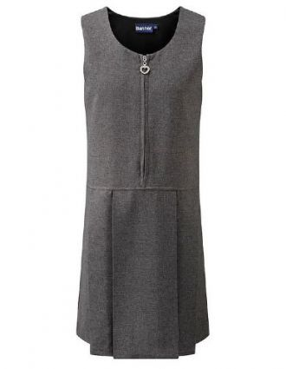
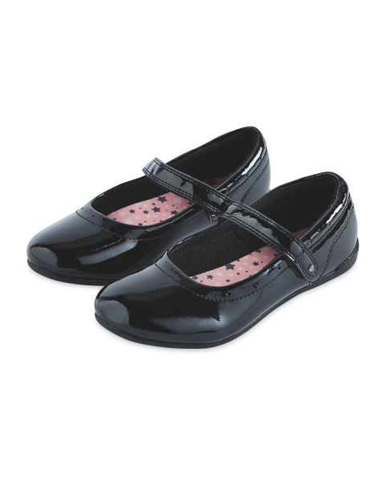
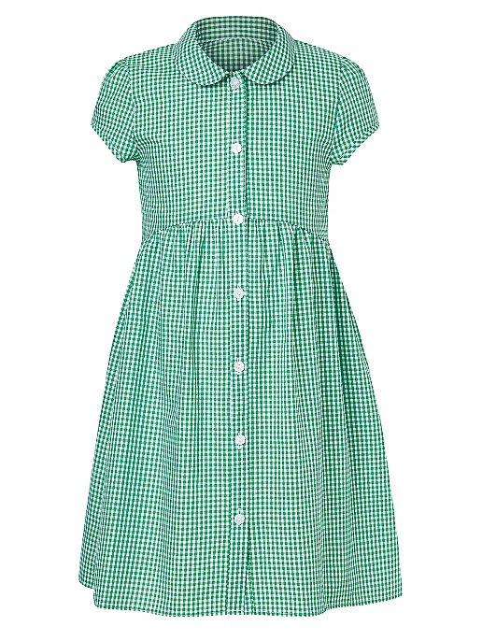
SCHOOL UNIFORM
Jumper
T-shirt/Shirt
Trousers
Dress/Skirt
Shoes
Summer Dress/Shorts

Slide 10
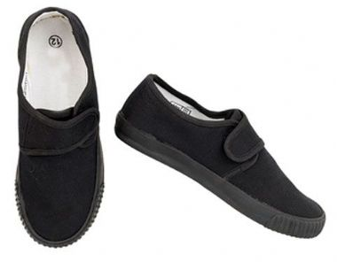
PE
Your child must wear the correct P.E kit to school.
They will need:
•White t-shirt
•Black shorts
•Black tracksuit bottom with elasticated ankles
•Trainers or plimsolls with velcro straps
For health and safety reasons, your child must not wear any watches
or jewellery, parents are asked to remove any earrings including studs.
Long hair must be tied back.
PE DAYS
Dragonflies –TUESDAY
Bumblebees – TUESDAY

Slide 11
Useful Websites
Phonics songs
‘zed version’
EYFS
Games
Login details for Mathletics, Letter-join and Collins Connect will be given separately.
Please remember to supervise your child when they are using the internet.

Slide 12
Final Note
Please do get in touch if you have any concerns or queries.
Bumblebee Class: Bumblebee@tottenhall.enfield.sch.uk
Dragonfly Class: Dragonfly@tottenhall.enfield.sch.uk
School Office: office@tottenhall.enfield.sch.uk

