Slide 1
Tottenhall Infant School
Year 2 Curriculum Spring Term 2024 Information For Parents and Carers

Slide 2
Year 2 Staff
Panda Class
Bear
Class
Koala
Class
Shahina
Sundeep
Irena
Nacera
Kyriaki
Esra

Slide 3
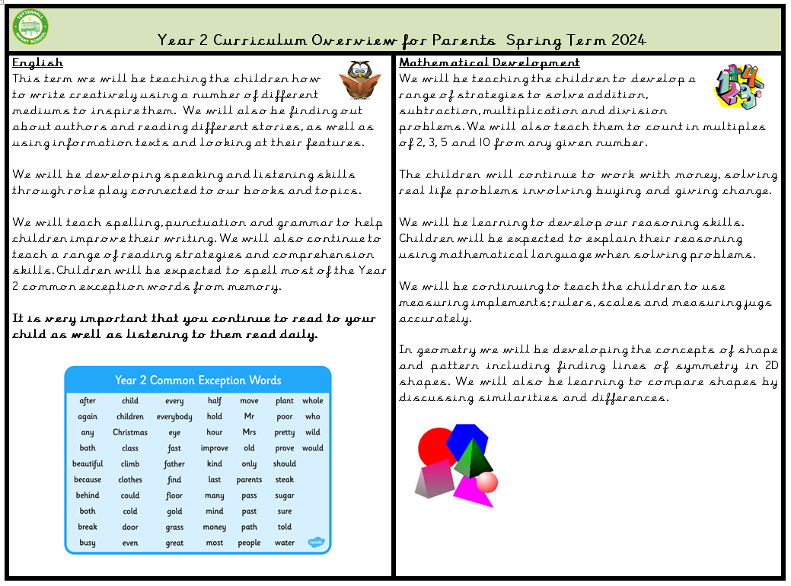
Year 2 Curriculum Focus Spring 2024

Slide 4
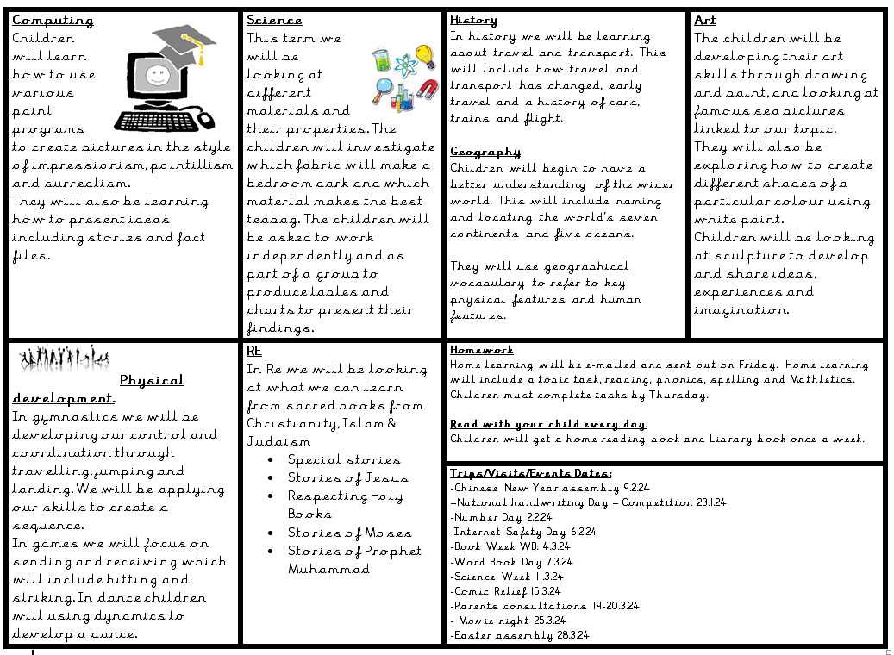
Year 2 Curriculum Focus Spring 2024

Slide 5
Phonics
Children have 2 phonic session per week.
Children are expected to use their phonic knowledge in reading and writing across all curriculum areas.
Those who did not pass the phonic screening assessment will be re-assessed in June.
Daily catch-up sessions for those who did not pass the phonics check, are falling behind or are new to school/English.
Assessed at the end of each half term.
Little Wandle for Parents
https://www.littlewandlelettersandsounds.org.uk/resources/for-parents/

Slide 6
Reading
Continue to read everyday during guided reading and other areas of the curriculum.
Focus for this term:
Continue to develop pleasure for reading
Read more independently
Read most words accurately without overt sounding and blending
Develop better fluency
Read words containing common suffixes
Discuss and clarify the meaning of words
Checking that the text makes sense
Answering and asking questions

Slide 7
Writing
Our focus this half term is:
Write alternative versions of a story.
Using the apostrophe to show possession and to contract e.g. do not = don’t.
Adding es to nouns and verbs ending in y.
Adding ing, ed, ly, er and est to root words ending in y.
Using connectives and conjunctions in our writing.
e.g. and so but because when if

Slide 8
Handwriting
•This term there is a focus on all children forming all letters correctly.
•Good presentation in books.
How you can help:
•Use Letter-Join online.
•Allow your child to write freely at home.
•Remind your child to write in Letter-Join when. completing homework.
•Practise will help children develop stamina and fluency when writing.

Slide 9
Maths
Number
Measure
Geometry
-Division (sharing and grouping)
-Money (using all calculations)
-Fractions-number
-Length
-Time
-2D shape and Symmetry
-3D shape including properties and similarities/ differences
-Fractions-shape
Problem solving and reasoning tasks across all areas.

Slide 10
Foundation Subjects
History
ART
RE
-Develop art skills through drawing and paint, and looking at famous sea pictures linked to the topic.
-Create different shades of a particular colour using white paint.
-Exploring and looking at sculpture to develop and share ideas, experiences and imagination.
-Travel and transport. -Include how travel and transport has changed, early travel and a history of cars, trains and flight.
-Special Stories of Jesus
-Respecting Holy Books
-Stories of Moses
-Stories of Prophet Muhammad

Slide 11
Foundation Subjects
Science
PE
Geography
-Materials and their properties.
-investigate which fabric will make a bedroom dark and which material makes the best teabag.
-Work independently and as part of a group to produce tables and charts to present their findings.
-Develop control and coordination through travelling, jumping and landing.
-Apply skills to create a sequence.
-Focus on sending and receiving which will include hitting and striking.
-In dance children will using dynamics to develop a dance.
-Develop a better understanding of the wider world.
-Naming and locating the world’s seven continents and five oceans.
-Use geographical vocabulary to refer to key physical features and human features.

Slide 12
Home Learning
Home learning will be sent out on Fridays and children need to submit or return their home learning on Thursdays.
Each child will have a home learning journal that they can use to record their work.
At the back of the learning journal you will find log-in details to on-line resources/websites they need to access.
Mathletics
-Your child will have their own log in
-Tasks will be set weekly
-Class teacher will check who is completing their tasks
-Tasks are linked to current learning in class
-There may be some additional challenges for the children to complete

Slide 13
Home Learning
These are the home learning tasks that children will have to complete every week.
Purpose of home learning
Parental involvement
School expectations
Working together
Fun
Linked to the curriculum
Purposeful
Creative
Collaborative
Motivating

Slide 14
EVENTS
- Chinese New Year assembly 9.2.24
– National handwriting day-Competition 23.1.24
-Number Day 2.2.24
-Internet Safety Day 6.2.24
– Book Week 4.3.24
-Word Book Day 7.3.24
-Science Week 11.3.24
- Comic Relief 15.3.24
- Parents consultations 19-20.3.24
- Movie night 25.3.24
- Easter assembly 28.3.24

Slide 15
Important
Home readers: Friday
Home learning: Sent home on Friday and must be returned on Thursday.
Libraray book: Bear Class- Tuesday - Panda Class-Wednesday Koala Class-Tuesday
PE Day: Bear Class- Tuesday Panda Class-Thursday Koala Class-Thursday
Dance: Bear Class-Thursday Panda Class-Tuesday Koala Class-Tuesday (no P.E kit, no earrings)

Slide 16
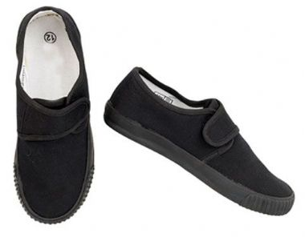
PE
Your child must wear the correct P.E kit to school.
They will need:
•White t-shirt
•Black shorts
•Black tracksuit bottom with elasticated ankles
• Black trainers or plimsolls with velcro straps
Please note as it’s getting colder children will need to wear tracksuit bottoms.
For health and safety reasons, your child must not wear a watch or jewellery, we will ask parents to remove any earrings including studs. Long hair must be tied back.

Slide 17
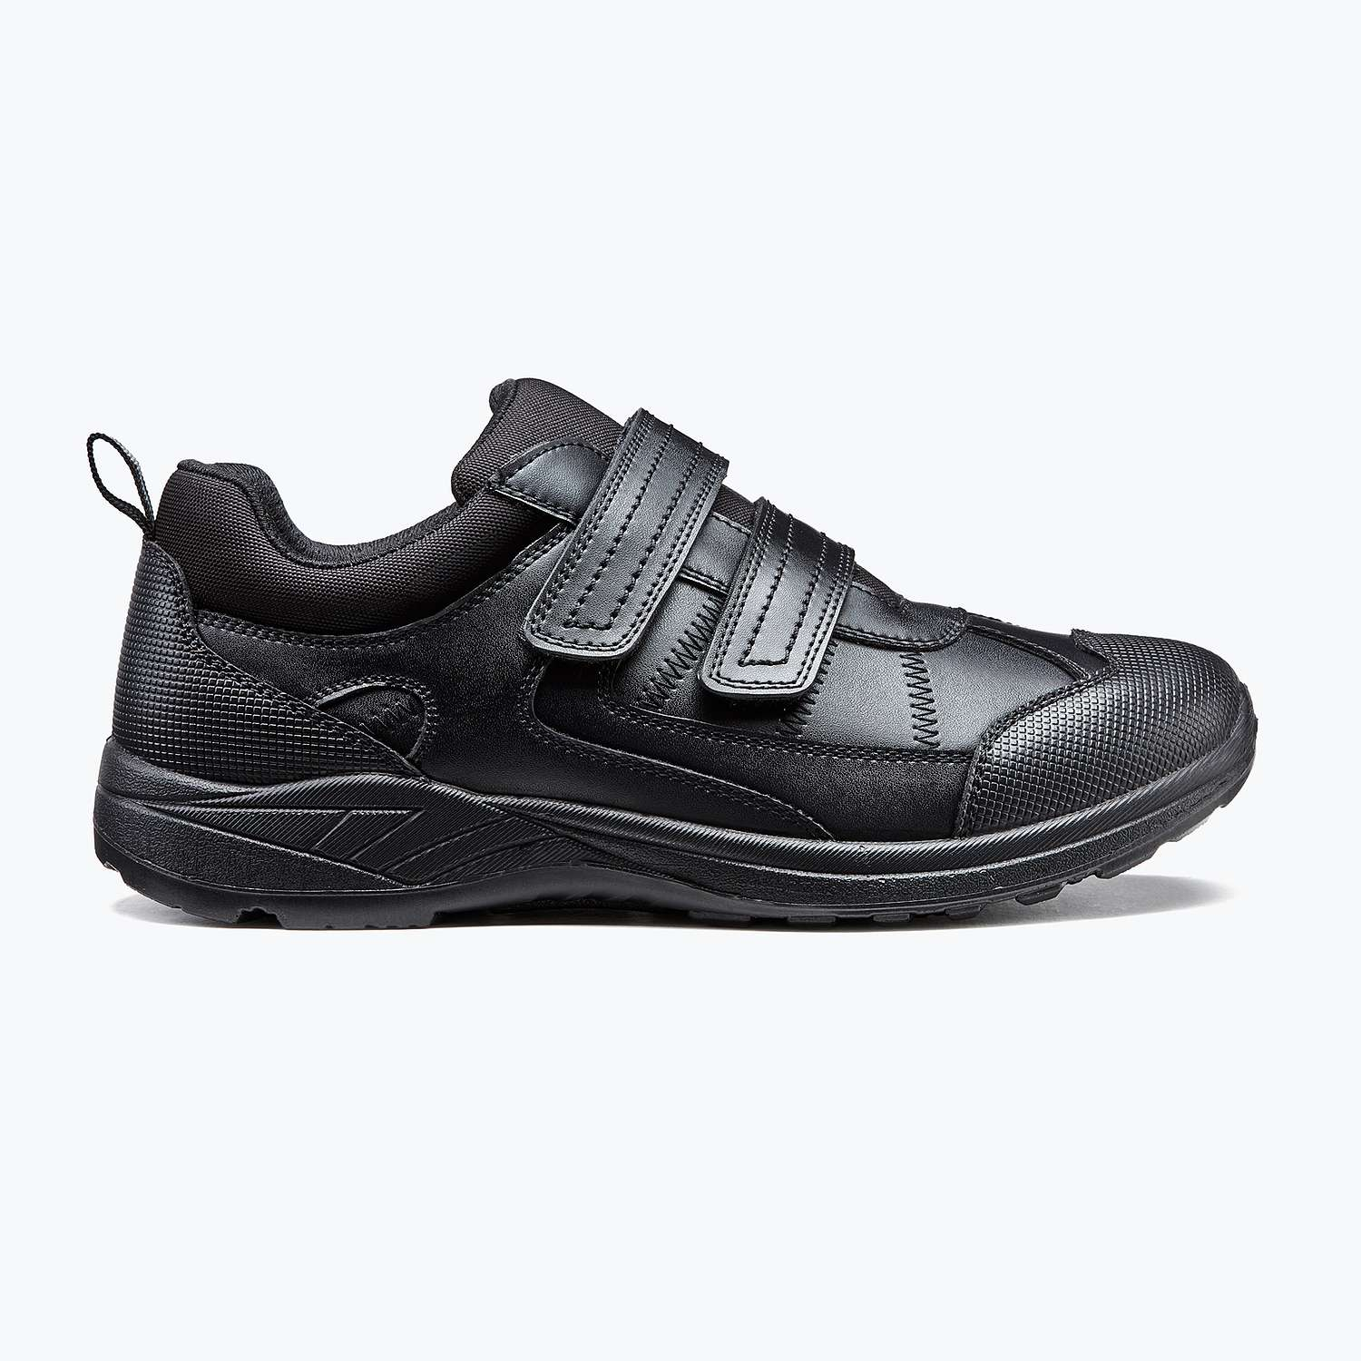
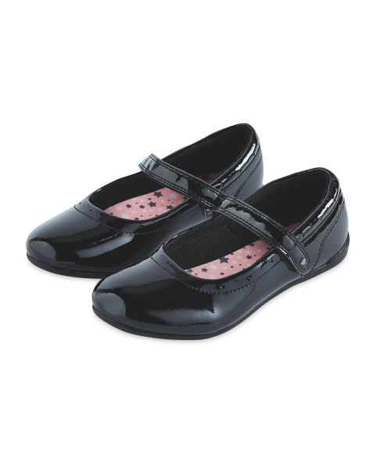
SCHOOL UNIFORM
Jumper
T-shirt/Shirt
Trousers
Dress/Skirt
Shoes
Summer Dress/Shorts

Slide 18
ATTENDANCE
•Please ensure your child is in school everyday unless they are unwell. Any sickness or diarrhoea must be followed by 48 hours from the last incident.
•School starts at 8.45am and finishes at 3.15pm.
•Children miss out and learning if they are absent and late.

Slide 19
Useful Websites
Login details will be given separately. Please remember to supervise your child when they are using the internet.

Slide 20
Final Note
Please do get in touch if you have any concerns or queries.
E-mail: office@tottenhall.enfield.sch.uk
Tel: 02088291100
Web: www.tottenhall.enfield.sch.uk
Class email:________________

