Slide 1
Tottenhall Infant School
Year 1 Curriculum Autumn Term 2023 Information For Parents and Carers

Slide 2
Year 1 Staff
Turtle Class
Seal
Class
Dolphin
Class
Carly
Kathy
Maria/Zulfica
Naila
Manjola
Sana
Tahira
Zulfica/Viera

Slide 3
Phonics
- We use Little Wandle Letters and Sounds to deliver phonics
- All pupils have been assessed on their phonic knowledge at the end of the summer term
- Phonics will be taught daily in year 1
- Children will cover Phase 2, 3, 4 and 5
-Aim of the phonics is for all children to be able to read independently through decoding and blending
- Phonics meeting later in the Spring Term
- Phonics screening in June 2024
- Read alien and real words
- Any pupils who do not pass the phonics screening test at the end of the year will be assessed again at the end of year 2

Slide 4
Reading
- All pupils have been assessed in reading and reading texts have been pitched accordingly
- There are daily guided reading sessions with a mix of adult led and independent reading
- Use phonics knowledge to break down words
- Read irregular words
- Demonstrate understanding of what they’ve read
- Pupils are expected to read across all areas of the curriculum
- Additional reading opportunities are planned for throughout the week and we expect children to make rapid progress
- There are many opportunities for children to read for pleasure
- Please ensure your child reads at home and remember to sign the reading record
Reading books will be changed once a week
Reading records must be in book bags and need to be signed/comment made
- You may need to pay for lost or damaged books

Slide 5
Year 1 Curriculum Focus Autumn 2023

Slide 6
Year 1 Curriculum Focus Autumn 2023

Slide 7
Writing
- Using their phonics knowledge to write words which make their spoken sounds
- Writing irregular common words
- Write simple sentences which can be read by others
- Stories with predictable phrasing
- Finger space, capital letters and full stops
- Talking about their writing with their peers and teachers

Slide 8
Handwriting
- We are using letter-join handwriting scheme
- Pre-cursive in year 1
- Home access for children to practice
How you can help:
•Use Letter-Join online
•Allow your child to write freely at home
•Remind your child to write in Letter-Join when completing homework
•Practise will help children develop stamina and fluency when writing

Slide 9
Maths
Place Value
Problem Solving
Geometry
Counting
Ordering
Writing
Comparing
Numbers
Number
Addition
Subtraction
Number bonds to 10
Properties of 2D shape

Slide 10
Home Learning
- Home learning will be e-mailed on Fridays and children need to return their home learning in their home learning books on Thursdays
- Each child will have a home learning journal that they can use to record their work
-At the back of the learning journal you will find log-in details for on-line resources/websites children need to access
-If you would like a paper copy please ask your child’s class teacher
Mathletics
-Your child will have their own log-in details
-Tasks will be set weekly
-Class teacher will check who is completing their tasks
-Tasks are linked to current learning in class
-There may be some additional challenges for the children to complete

Slide 11
Home Learning
These are the home learning tasks that children will have to complete every week.
Purpose of home learning
Parental involvement
School expectations
Working together
Fun
Linked to the curriculum
Purposeful
Creative
Collaborative
Motivating

Slide 12
Important
Home readers: Turtle-Monday
Seal- Wednesday Dolphin-Wednesday Home learning: Sent home on Friday and must be returned on Thursday.
Library book: Turtle-Thursday
Seal- Wednesday Dolphin- Friday
PE Day: Tuesday and Thursday

Slide 13
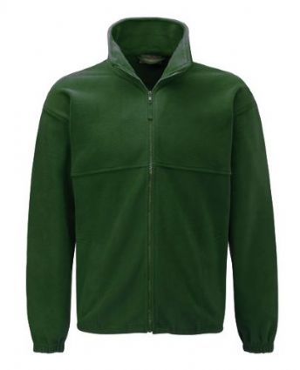
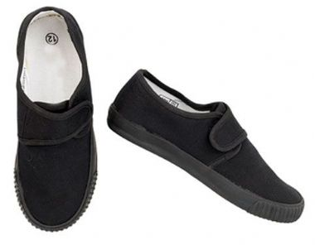
PE
Your child must wear the correct P.E kit to school.
They will need:
•White t-shirt
•Black shorts
•Black tracksuit bottom with elasticated ankles
• Black trainers or plimsolls with velcro straps
Please note as it’s getting colder children will need to wear tracksuit bottoms.
For health and safety reasons, your child must not wear a watch or jewellery, we will ask parents to remove any earrings including studs. Long hair must be tied back.

Slide 14
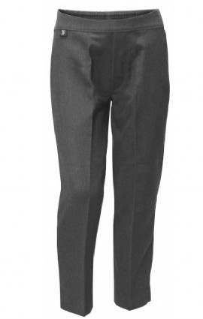
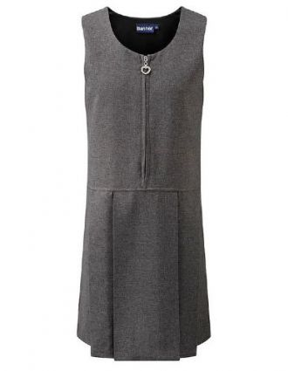
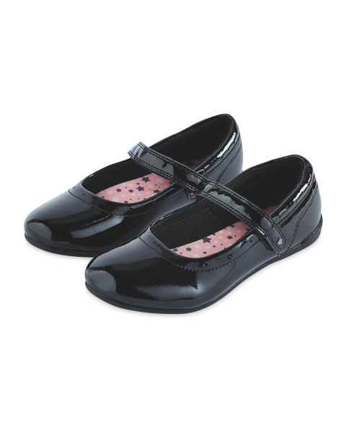
SCHOOL UNIFORM
Jumper
T-shirt/Shirt
Trousers
Dress/Skirt
Shoes
Summer Dress/Shorts

Slide 15
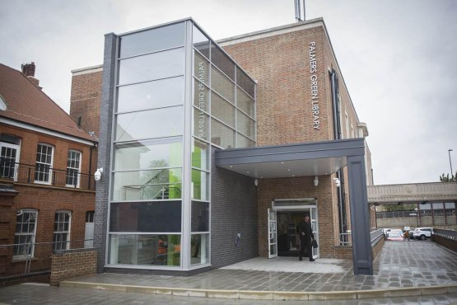
EVENTS
Harvest Festival- 06.10.23
Fire Safety Day: 19.10.23
Palmers Green Library Visit: WB 01.11.23
Kindness Day: 13.11.23
Children in Need: 17.11.23
Road Safety Day: 20.11.23
Movie night: 12.12.23
Church visit: December
Christmas performances: December
Dates to be confirmed- they will be shared with you once confirmed.

Slide 16
ATTENDANCE
•Please ensure your child is in school everyday unless they are unwell. Any sickness or diarrhoea must be followed by 48 hours from the last incident.
•School starts at 8.45am and finishes at 3.15pm.
•Children miss out and learning if they are absent and late.

Slide 17
Useful Websites
Login details will be given separately. Please remember to supervise your child when they are using the internet.

Slide 18
Final Note
Please do get in touch if you have any concerns or queries.
E-mail: office@tottenhall.enfield.sch.uk
Tel: 02088291100
Web: www.tottenhall.enfield.sch.uk
Class e-mail: turtle@tottenhall.enfield.sch.uk
seal@tottenhall.enfield.sch.uk
dolphin@tottenhall.enfield.sch.uk
Thank You

